Slide 1
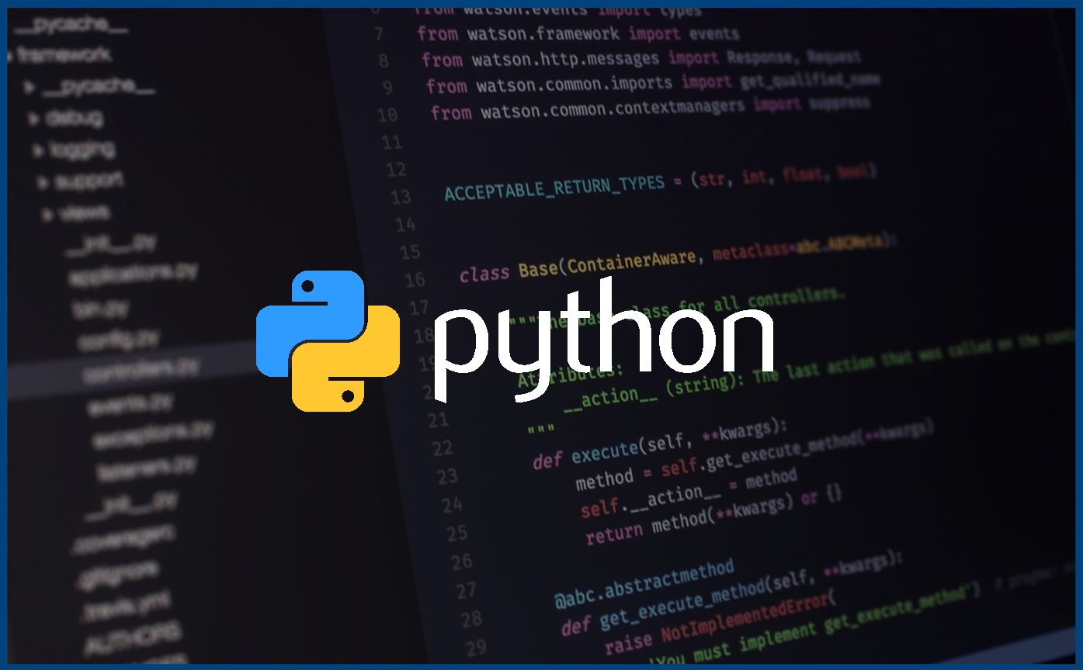
Introduction to Python!

Slide 2
Hello!
I am Seth Shickluna
I am a Computer Science student and Python enthusiast
You can contact me at sethshicklunapierce@gmail.com

Slide 3
About this course
Today’s Content
Today we will be installing Python on our computers, getting everything setup, and writing our first programs!
We will need the following:
Python 3
https://www.python.org/downloads/
Some program that we can write code in
https://www.jetbrains.com/pycharm/
https://code.visualstudio.com/
Everything shown in the course (code, slides, etc) will be uploaded to the google classroom
Course Schedule
This course is designed to cover all the material and concepts that a Grade 10 computer science course would teach. To do this we will be learning how to write code in Python and covering the curriculum alongside that.
Getting Python setup and writing our first script
Python Basics, syntax and I/O
Data types
Mathematical Operators, comparisons
Control structures and loops
Making interactive programs
Problem solving with python
First Assignment
Arrays and Lists
Tuples and Dictionaries
Review
Unit 1 Quiz

Slide 4
1.
What is Python

Slide 5
Python is a high level, dynamically-typed, interpreted programming language

Slide 6
What does this mean?
Interpreted: Each line of code is processed one after the other
Dynamically Typed: We don’t have to tell the computer what kind of “variables” we are using - it just knows
High Level: the “syntax” of python (how it is written) is very close to english and is easy to read

Slide 7
What can we do with Python?

Slide 8
All sorts of stuff!
Web development
Artificial intelligence
Web scraping
Large software projects
Game development
Data Science (Processing large amounts of information)
Making your math homework easier!

Slide 9
Benefits of Python
Clear Syntax
Simple syntax makes python accessible for everyone, and makes it easy to test your code
Scalable
Python projects range from simple scripts to large software systems, including applications from Google, Spotify, and Netflix!
Versatile
The practical applications of Python are endless, it can do a little of everything and is not limited to just certain types of programs

Slide 10
Getting Python Installed:
To start writing code, we will need two things
Python itself
An editor where we can write and run python code

Slide 11

Ready to start?
Let's write our first program.

Slide 12
The print() function
print() is a built in function in Python
The parenthesis following the word, tells the Python Interpreter to “execute” this function
Inside the parenthesis, we can put text which Python will then print on the screen
By default, the print() function creates a new line once it has been printed

Slide 13
Strings!
In programming a string is one or more characters marked with quotes
“This is a string!”
“” is also a string
Strings can be assigned to variables
same = “Seth”
We are storing the string “seth” in a variable called name
We can use ‘f-strings’ to print include more data when printing
print(f”Hello {name}.”)
We will learn more about strings and variables in future lessons

Slide 14
Printing precisely
print() can take any number of arguments.
Arguments are input into functions
In this case they are called ‘positional arguments’ as any number of them can be inputted
The print function has, optional arguments
sep
print(“Hello”, name, sep=”’’)
sep tells print() what character to place between each argument
By default this is a space character ‘ ‘
end
Tells print() which character to end on
By default this is a newline “\n”

Slide 15
Exercise 1:

Slide 16
The input() function
input() is another built in function in Python
The arguments of input can be used to to pass a string which prompts the user
input(“What is your name?”) would prompt the user to type their name
Once input is called it will wait for the user to type some text and press enter
Perhaps we should do an example

Slide 17
Jupyter Notebooks
I will probably use these for all code examples in future lessons
What is a notebook?
Allows us to write “cells” of code which maintain information/data throughout the entire
Allows us to markup text, and denote our code cells
Gives a clear view of code, what is happening, and how it works
Uses the file extension .ipynb
Let’s make one and see how they work

Slide 18
The Python Package Manager
The ‘unofficial’ way to download and use 3rd party python code is to use the python package manager
This tool is called pip
To install a package simply call pip install <package name>

